Slide 1
The Cell Line Ontology
Sirarat Sarntivijai, Zuoshuang Xiang, Terrence F Meehan, Alexander D Diehl, Uma Vempati, Stephan Schurer, Chao Pang, James Malone, Helen Parkinson, Brian D Athey, Yongqun He

Slide 2
Background
Why CLKB/CLO?
Cell cultures widely used in research, but no real central reference on naming and qualification
Contamination is an on-going issue
2007 release of Cell Line Knowledgebase (CLKB)
Needing the place to hold information of cell cultures, issue deriving from development of the Cell Ontology (CL)
~9,000 cell line entries drawn from ATCC and HyperCLDB
Basic information, minimal hierarchy structure
Mainly viewed as cell line catalogue
Request for fully-developed ontology of cell lines by community
Collaboration as consequence of request
Cell Ontology Development Team (Jackson Laboratory)
European Bioinformatics Institute (EBI)
The BioAssay Ontology (BAO) at the University of Miami

Slide 3
What’s new in CLO?
OBO Foundry conformance
Fully-developed ontology PLUS individual listing of cell line entries (knowledgebase)
Importing terms from external source ontologies, keeping original namespace of those imported for reference links
Collaboration and Community support
Sourceforge developing workspace: open access
http://sourceforge.net/projects/clo-ontology/
Special thanks to CL (T. Meehan, A. Diehl), EBI (C. Pang, J. Malone, H. Parkinson), and BAO (U. Vempati, S. Schurer)

Slide 4



CLO Cell Lines in Functional Genomics, EBI
ArrayExpress and Gene Expression Atlas contain cell lines studying many genes (over 50k in Atlas alone)
Bio-sample Database at EBI www.ebi.ac.uk/biosamples will require ontology with great number of cell lines
Currently described in EFO www.ebi.ac.uk/efo which will import cell line ontology, already imports cell type, OBI and others
Primary use cases are for curation, querying, data integration and visualization
Coriell Cell Line ontology working with the cell line ontology group to be interoperable

Slide 5
CLO in CL: Enhancing content
Ontology of Biomedical Investigations (OBI)
Cell line ontology (CLO)
Plant ontology
Notes:
"The editors of CL feel that the term "experimentally modified cell" is better represented as an output of an OBI process. One type of output is "permanent cell line cell", types of which are represented in CLO. These high level terms are left in CL as we resolve the best way to bridge between the respective ontologies . In addition, specific types of cell line cells can reference the cell types in CL that they are derived from, as will be discussed in the next couple of talks

Slide 6
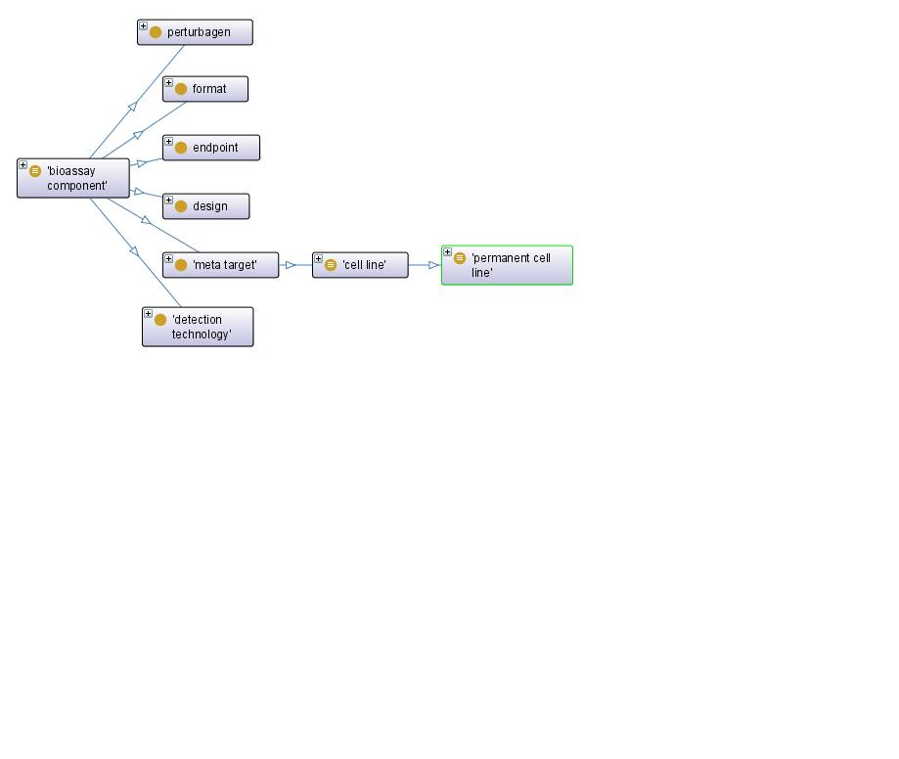
CLO in BAO: Describing cell lines in assay
Cell line modification
Stable
transfection
has_specified_input
has_specified_output
derives_from
Modified
cell line
has_a
STR_ profile
has_specified_input
cell culturing
is_a
cell line
culturing
is_a
adherent
cell line culturing

Slide 7
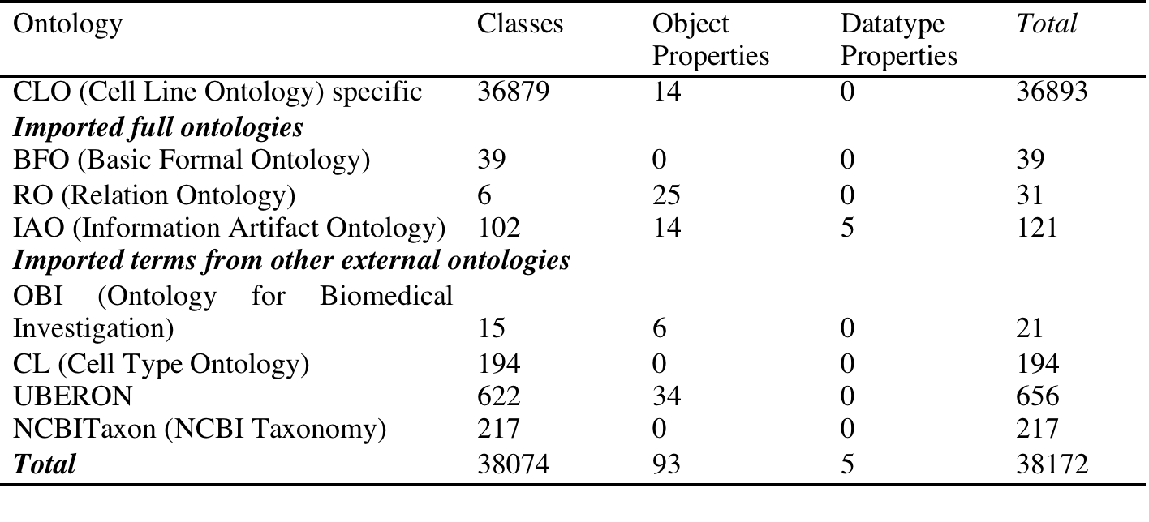
Summary: source ontologies & terms

Slide 8
Design – CLO Hierarcy

Slide 9
CLO Design Pattern

Slide 10
Example: Jurkat

Slide 11
Example: describing HeLa in BAO

Slide 12
Importing external terms: The challenge
Investigating imported terms
CL:
cell + anatomical Part: ‘breast cell’
multiple identifiers: ‘embryonic colon epithelial cell’ (embryo + anatomical part + cell)
non-human organ/tissue: gill, fin, larvae
tissue described with derivative of another cell line, modification of a cell line *
hybrid/cancer cell lines
case study of T Cell/Lymphocyte/Lymphoblast e.g. Jurkat
EBI Coriell Cell Lines
additional information (e.g. disease – may need normalization)
BAO Cell Line Modification
Tools:
OntoFox
Computer programming

Slide 13
CLO Applications
CLO as knowledgebase
CLO to facilitate data entry of archival repositories
CLO to validate existing cell culture information
CLO to authenticate cell lines: ATCC SDO cell line authentication method by Short Tandem Repeat (STR) profiling, information being added to CLO by the next release
CLO for translational informatics: connecting bench to bedside

Slide 14
Discussion on future direction of CLO
The CLO Consortium
Distinguish: Primary Cell (Culture)/ Primary Cell Line/ Permanent Cell Line
Precise definition:
Major cell line’s characters (organism/ tissue type/ etc) do not change from passage to passage
Permanent/Continuous: undefined number of passages
Primary: finite number of passages
Stem Cell Lines: not covered due to conflict in defition

Slide 15
Terry’s Notes on scoring for CL term mapping
"just cell" = you should reference Cell ontology term "cell" plus an anatomy term. This is for cell lines with no description beyond a tissue, ex: "breast cell". CL would become very cluttered if we had to make a cell type for every tissue or organ part
"OBI" = something about the description implies culturing conditions like "adherent", or experimentally modified cells like "GFP". More appropriate for OBI.
"fetal"= fetal or embryonic in description. Just discussed with Alex and we feel that terms like "colon epithelial cell from embryo" should just reference CL "colon epithelial cell". We'll add embryo or fetal cell terms when they are unique to development, or have differences that distinguish them from adult cells.
"more than one cell type" = description indicates more than one cell type
"cancer" = cell comes from tumor. Most cases can still identify a CL term to link to but you'll need to indicate cancerous source. Terms with metastasis are confusing though as was the cell line derived from a bone marrow cell that metastasized elsewhere, or cell of unknown origin that metastasized to the bone marrow.

Slide 16
OntoFox Imports
Input: set of terms
Specify axioms
OntoFox-processing to determine intermediate concept structure (e.g. finding extra terms to accommodate term import such as upper-level terms to make the hierarchical term integration as conforming to given axioms as possible)
Cell Lines (CLKB, Coriell), CL, Uberon done by scripting programming
OBI, NCBI_Taxon, FMA, Disease Ont terms imported by OntoFox
Notes:
Inconsistency in terms used
- singular/plural form larva,larvae
Go with singular, make plural an exact synonym
- noun vs. adjective
embryo fibroblast, embryonic fibroblast
Case by case whether to go with noun or adjective ( in this case, embryonic is more heavily used). Make the term you don't use an exact synonym
- Variations by spelling
Gasser's node written as Gasser_s node
kidney (cortex), proximal tubule, epithelial
kidney (corext, proximal tubule), epithelial
Use synonyms for variations in spelling (i.e. between british and US english) but I would correct obvious misspellings
Non-human organ/tissue
gill, fin, larvae
Hmm. If you don't know the species, CL can create a general term like gill cell by a cross-product to Uberon "gill". If you know the species, I would link CL to a species-specific anatomy if it exists. If not, we can make an is_a child to the general term "gill cell", and add a only_in_taxon restriction.
Tissue described as derivatives of another cell line
HeLa contaminant, epithelial
HeLa transformed with adenovirus E1a and E1b, epithelial
OBI?
Ambiguous/ non-informative terms, broad general terms
Hybrid
lymphoblast, lymphoblast ; should I assume cell-comma-cell a hybrid?
I would guess a hybrid.
mammary gland, epithelium, epithelial
epithelium = epithelial. Glands are types of epithelial cells.
mast cell, mast cell
Not sure, never heard of mast cell hybrids.... wait a minute...
http://www.ncbi.nlm.nih.gov/pubmed/1827410
monocyte, monocyte
hybrid
monocyte-macrophage ; cell-dash-cell is a hybrid?
probably not. Macrophages derive from monocytes. My experience is most cell lines are monocyte, but one can get them to become macrophages by adding in growth factors in culture.
mixed
mixed connective and soft tissue
mixed skin and muscle, fibroblast
Yeah... tough one. Put aside for further discussion with a bigger group
ovary, mixed
ovary, varied
could get away with ovary cell, cell part_of ovary
lung or broncus
lung or broncus (metastasis)
lung or broncus, fibroblast
Need further discussion with a bigger group
nervous system
Uhm... hard to address as there are many different cell types in the nervous system
neural
neuron?
NULL
unknown
Hah!
unknown, epithelial
unknown, fibroblast
CL has epithelial cell, and I think fibroblasts
unknown, possibly whole embryo
unknown, possibly skin
unknown, possibly kidney ; how should I handle speculation?
Need further discussion with a bigger group
Different category under one parent
intestine, ileum
intestine, small
ileum is a specific part of the small intestine. Based on how confident you feel in the source data, you could go with the more specific or more general term
larvae, epithelial
larvae, minced
larval cell.

